Slide 1
Session 1
Software QA and Automation
Type of tests [Functional / Non functional]
Test-Case / Test-Suite / Test-Scenario
Test Tools and Frameworks
What is Selenium and how it works?
Sample of Automation with Selenium

Slide 2







Test tools and Frameworks

Slide 3
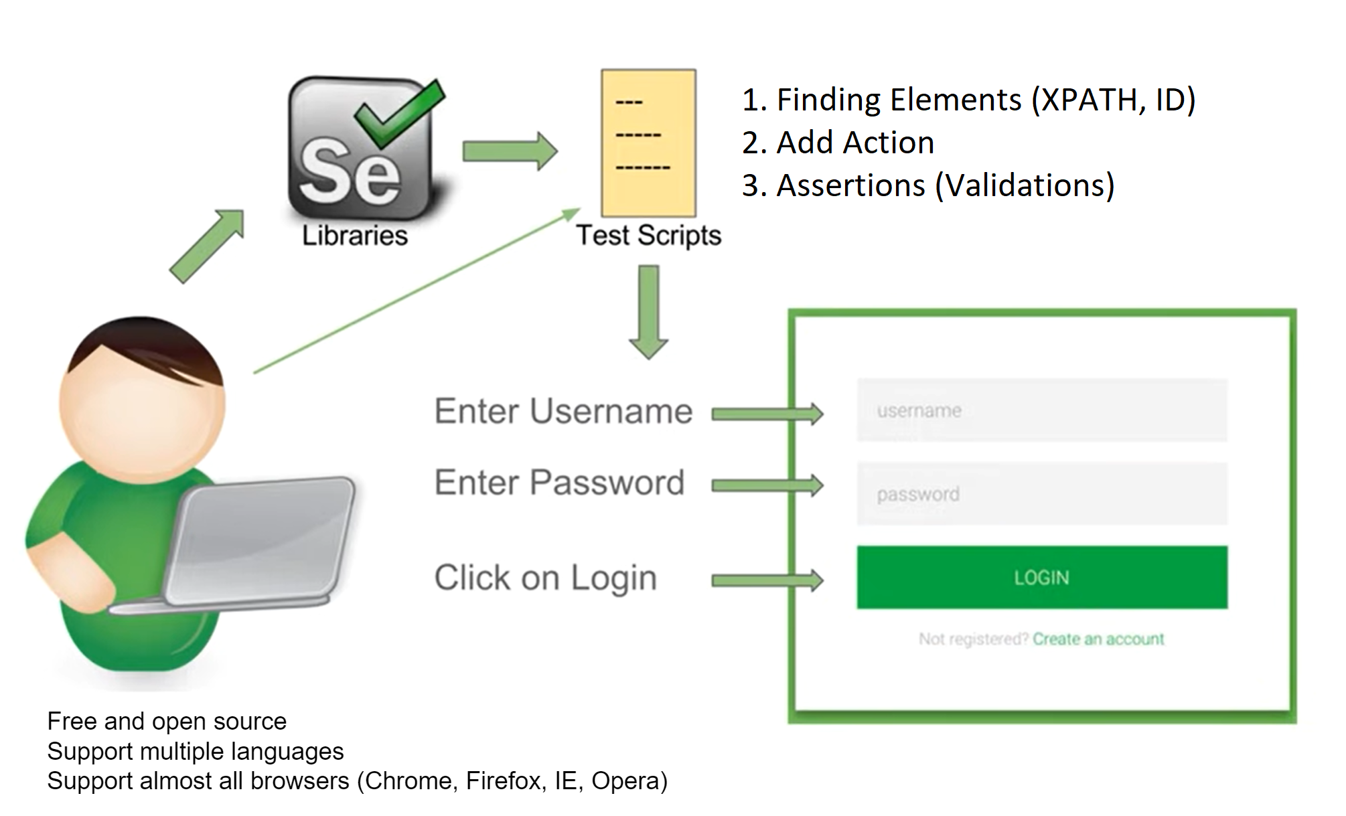
What is Selenium?
Notes:
Free and open source Support multiple languages Support almost all browsers (Chrome, Firefox, IE, Opera)

Slide 4
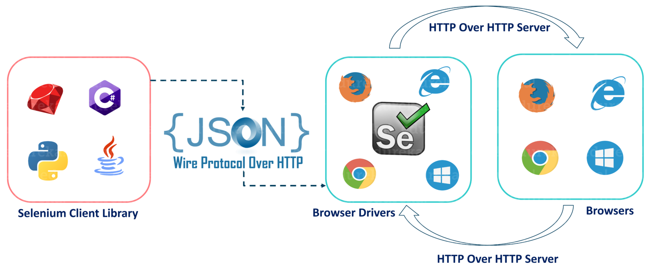
How Selenium works?

Slide 5
First Script!
Install Python
Install Pycharm
Install Selenium Library
First Sample
Some Driver Actions
https://testautomation-playground.herokuapp.com/index.html

Slide 6
Python Fundamentals
Basics and Syntax
Variables
List/Dictionary/Tuple
Strings
Control Flow and Loops (Decision Making)
Functions (Keywords) and Modules
OOP
Some Resources:
https://websitesetup.org/wp-content/uploads/2021/04/Python-cheat-sheet-April-2021.pdf
https://www.tutorialspoint.com/python/index.htm
https://www.youtube.com/playlist?list=PLhW3qG5bs-L9JjtXx-adxWdbjaxeRhi7h
https://www.sololearn.com/learning/1073

Slide 7
Session 2
Create project in Github
WebDriver Manager
requirements.txt
Teardown
Browser Actions
Execute JavaScript Commands
Taking Screenshot
Debugging
Chrome Options

Slide 8
Session 3
DOM and XML?
Strategies:
ID
XPath
Tag
Name
Link Text / Partial Link Text
Class Name
CSS
Chrome Extensions

Slide 9


Slide 10
Xpath
Syntax
Absolute and Relative
Contains
and / or
starts-with
Parent and Tricks
Child and Tricks
Finds / List
Relative / above()
Relative / below()
Relative / toLeftOf()
Relative / toRightOf()
Relative / near()

Slide 11
Session 4 – Xpath (Basics)
Syntax
Absolute and Relative
Attributes (id, name, value, text, class,…)
and / or
Parent & Child
Index
Element as attribute

Slide 13
Absolute XPATH
/html/body/div[3]/div[2]/form/fieldset/input[9]
Relational XPATH
// input [name=‘Options’]

Slide 14
// tag [ condition1 ]
// tag [ condition1 and condition2]
// tag [ condition1 or condition2]
// tag [ (condition1 or condition2) and condition3]
// tag [ condition1 ] /.. #Parent
// tag [ condition1 ] / tag [ condition2 ] # Child
// tag [ condition1 ] // tag [ condition2 ] # Search through children

Slide 15
// tag [ condition1 ] [index]
( // tag [ condition1 ]) [index]
// tag [ tag [ condition1 ] ]
// tag [ .// tag [ condition1 ] ]

Slide 16
Session 5 – Xpath (Functions)
contains()
starts-with()
position()
last()
count()
normalize-space()
translate()
string-length()
round()
floor()
not()
substring-before()
substring-after()

Slide 17
contains()
// * [ contains(text(), 'string')]
// * [ contains(text(), 'string') and @id='some-id']

Slide 18
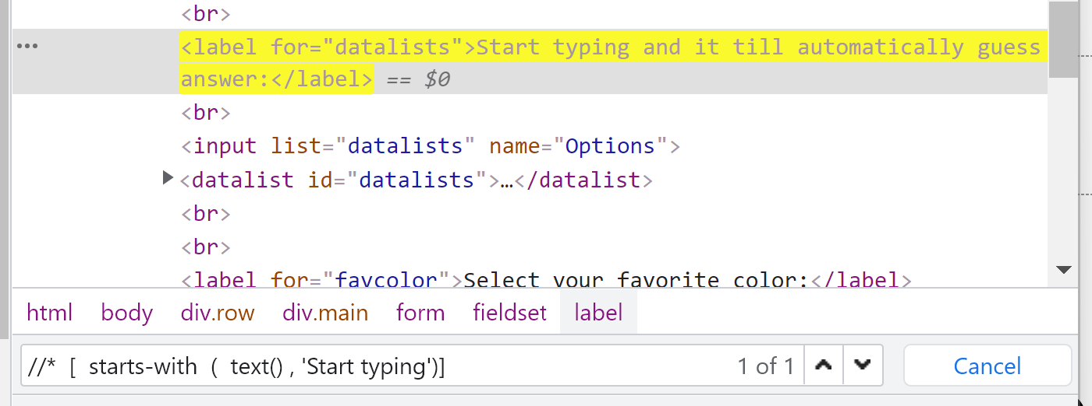
starts-with()
// * [ starts-with(text(), 'string')]

Slide 19
position()
// * [ position() = 3] //starts from 1

Slide 20
last()
// * [ last()]

Slide 21
count()
// tbody [ count (.//tr) = 7 ]

Slide 22
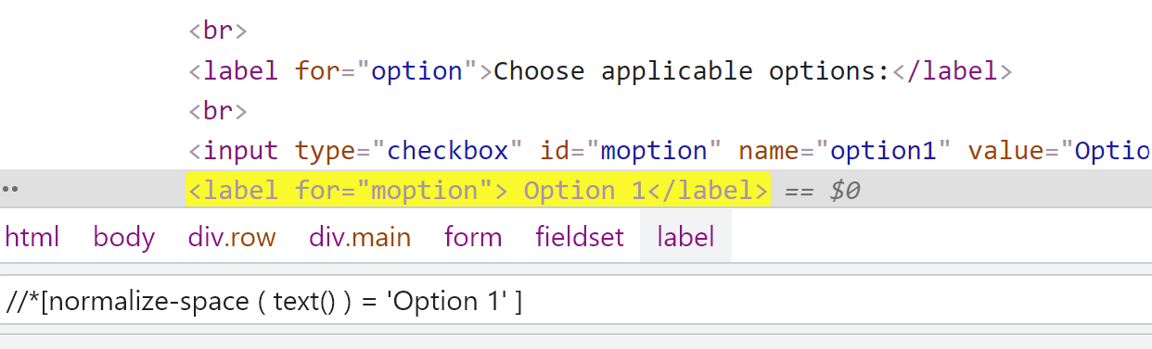
normalize-space()
// *[ normalize-space ( text() ) = 'Option1' ]
// *[ normalize-space (@id) = 'Option1' ]

Slide 23
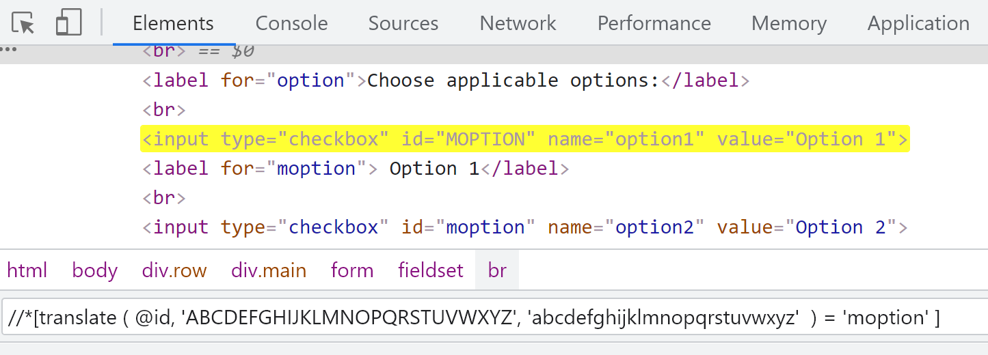
translate()
// *[ translate (text(), 'OPTION', 'option') = 'option1' ]

Slide 24
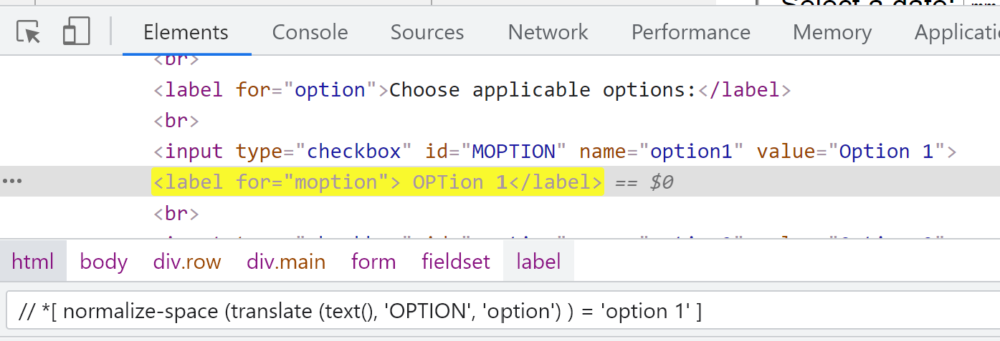
Combine normalize-space() and translate()
// *[ normalize-space (translate (text(), 'OPTION', 'option') ) = 'option1' ]

Slide 25
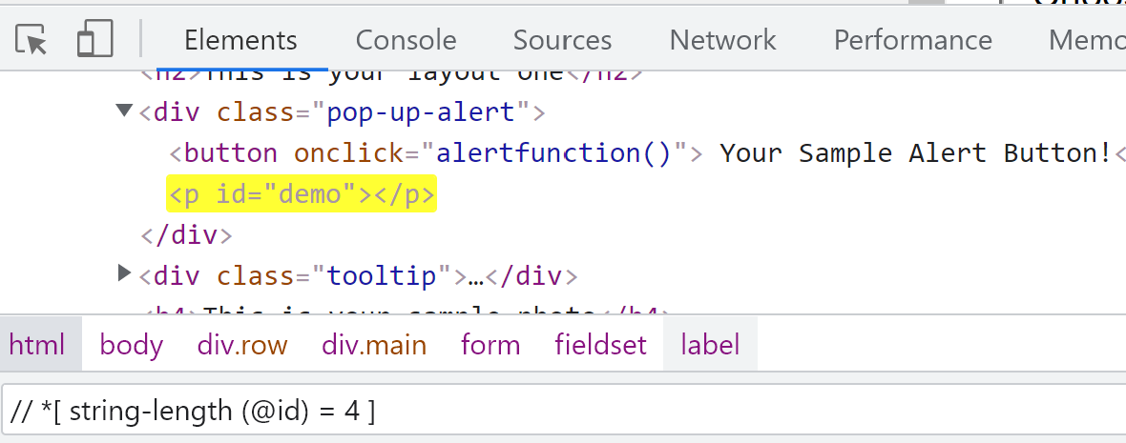
string-length()
// *[ string-length (text()) > 30 ]
// *[ string-length (@id) = 4 ]

Slide 26
round()
// td [ text() = '53.76' ]
OR
// td [ round (text()) = '54']

Slide 27
floor()
// td [ text() = '53.76' ]
OR
// td [ floor (text()) = '53']

Slide 28
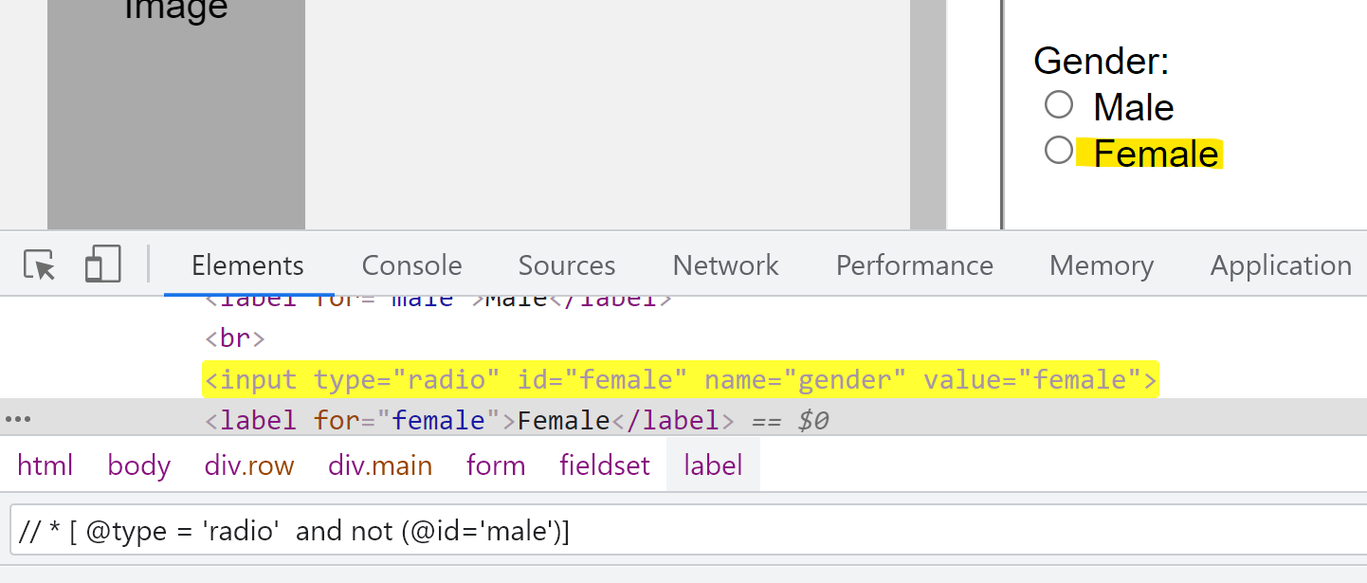
not()
// * [ type() = 'radio' and @id='femail']
OR
// * [ type() = 'radio' and not (@id=‘male')]

Slide 29
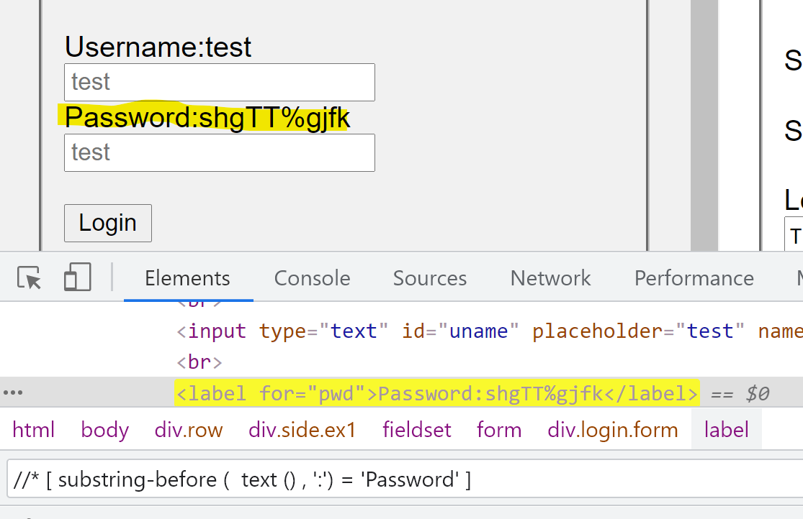
substring-before()
//* [ substring-before ( text () , ':') = 'Password' ]

Slide 30
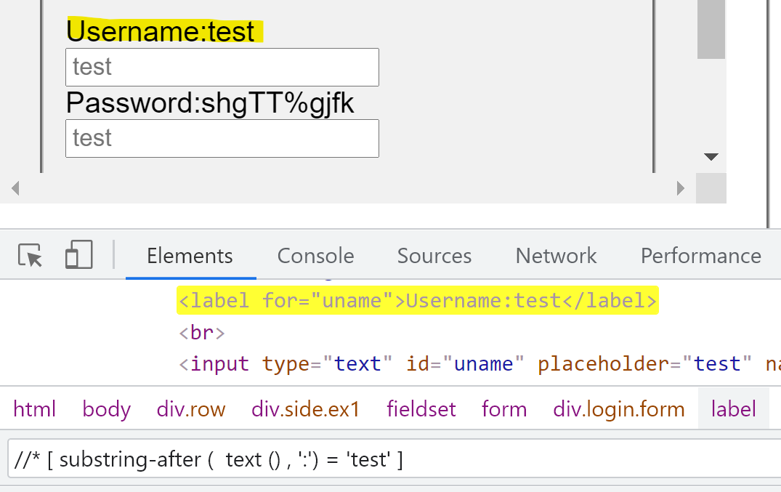
substring-after()
//* [ substring-after ( text () , ':') = 'Password' ]

Slide 31
Session 6 – Xpath (Axes)
parent
ancestor
ancestor-or-self
child
descendent
descendent-or-self
following
following-sibling
preceding
preceding-sibling

Slide 32
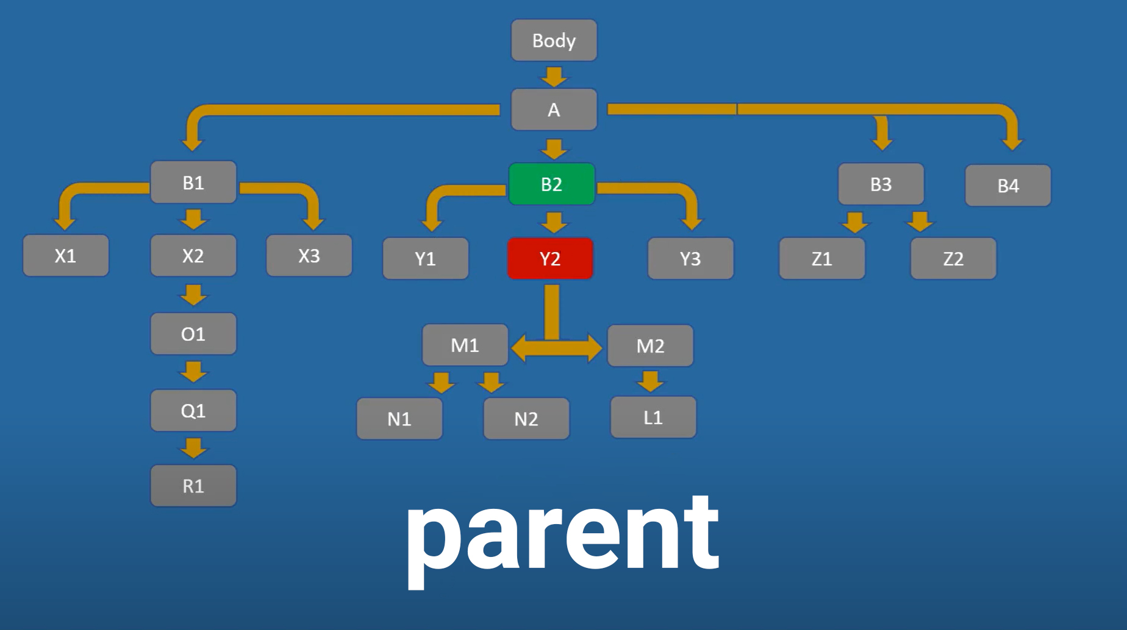
//* [@id=‘abc’] / parent :: *[@id=‘def’]

Slide 33
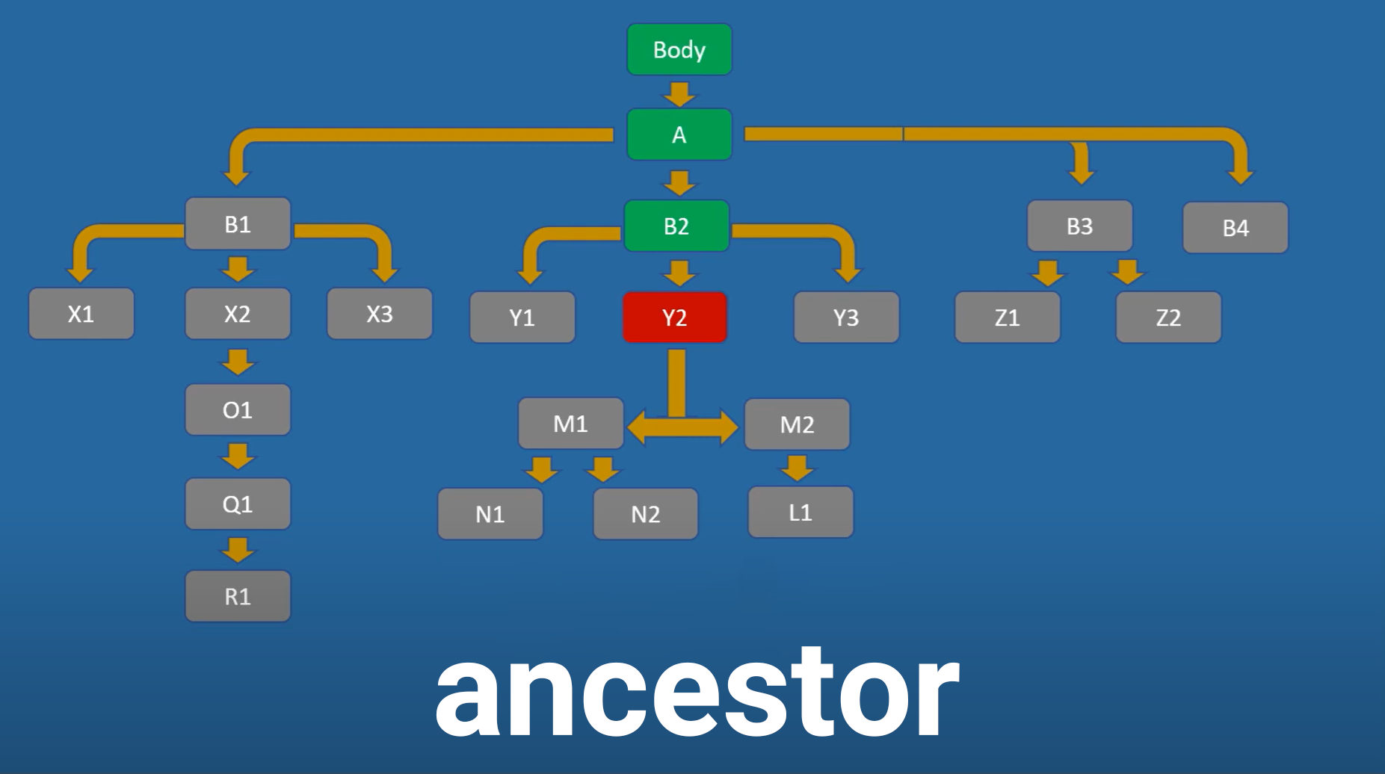
//* [@id=‘abc’] / ancestor :: *[@id=‘def’]

Slide 34
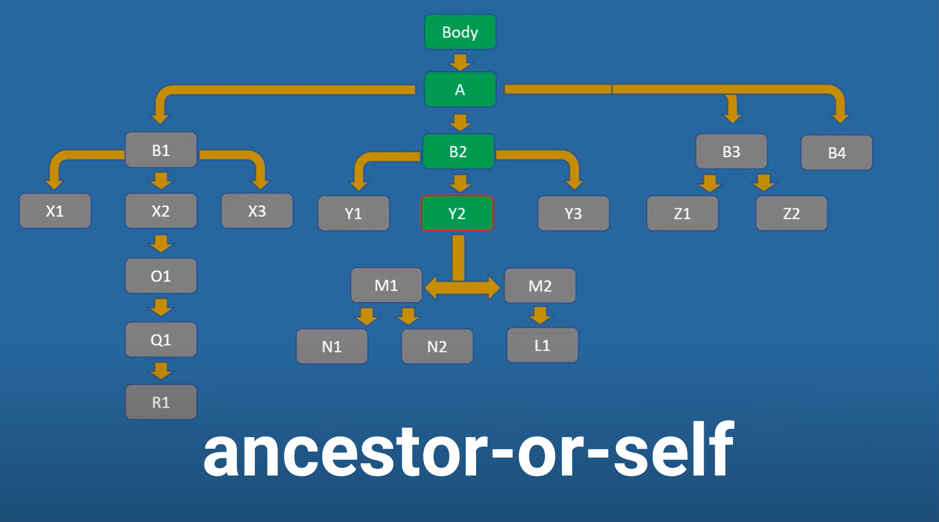
//* [@id=‘abc’] / ancestor-or-self :: *[@id=‘def’]

Slide 35
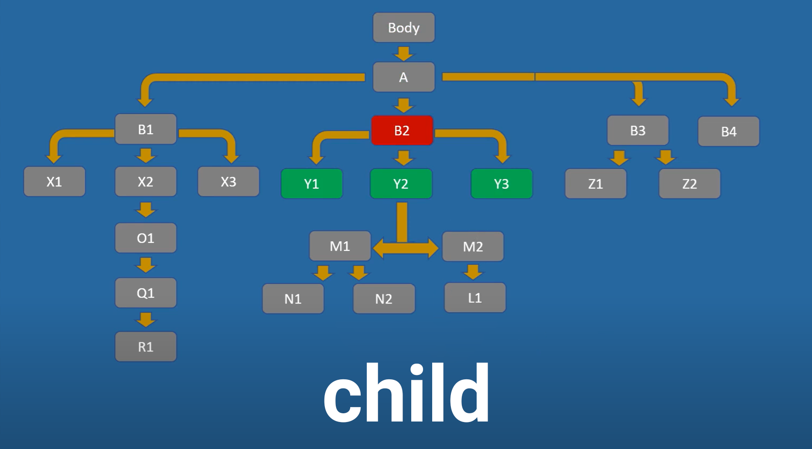
//* [@id=‘abc’] / child :: *[@id=‘def’]

Slide 36
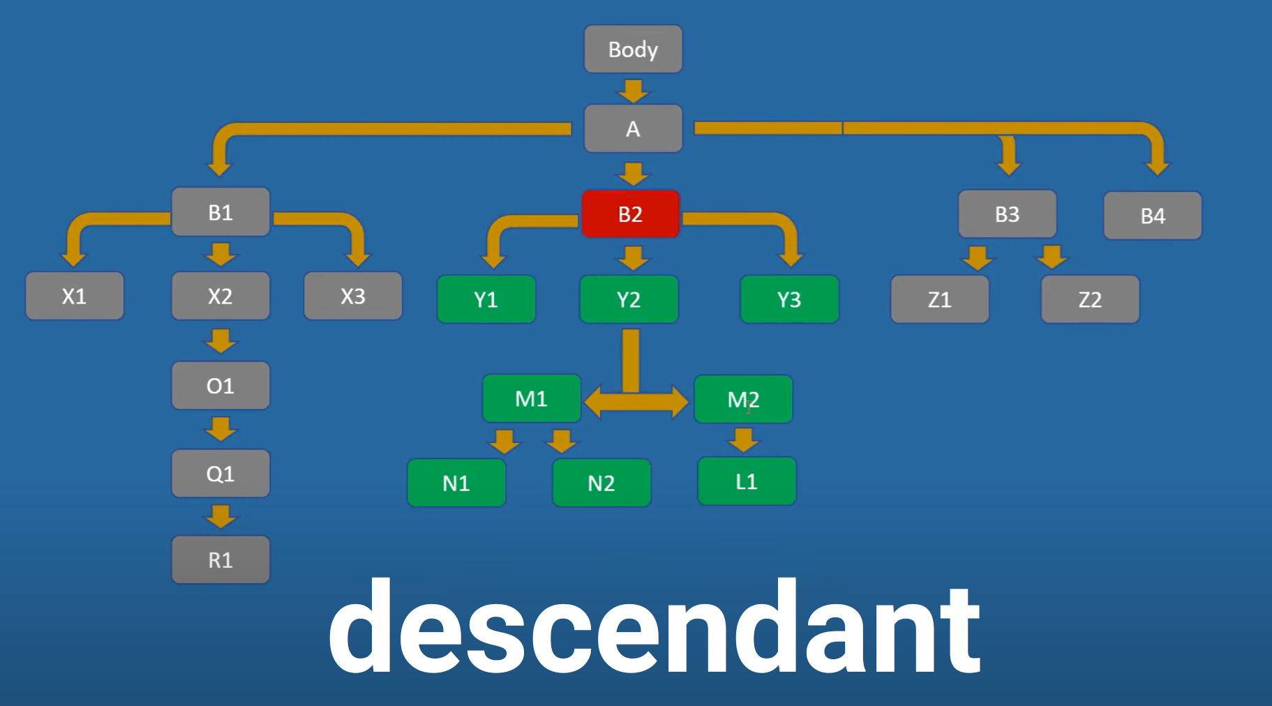
//* [@id=‘abc’] / descendant :: *[@id=‘def’]

Slide 37
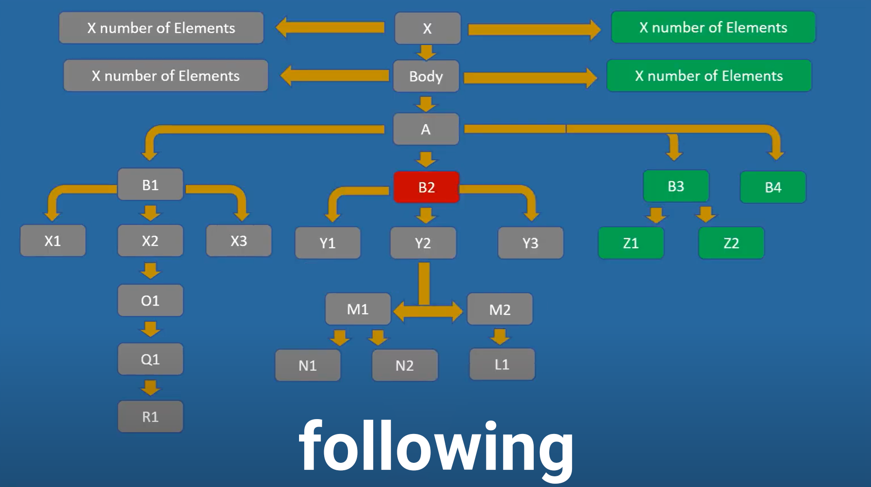
//* [@id=‘abc’] / following :: *[@id=‘def’]

Slide 38
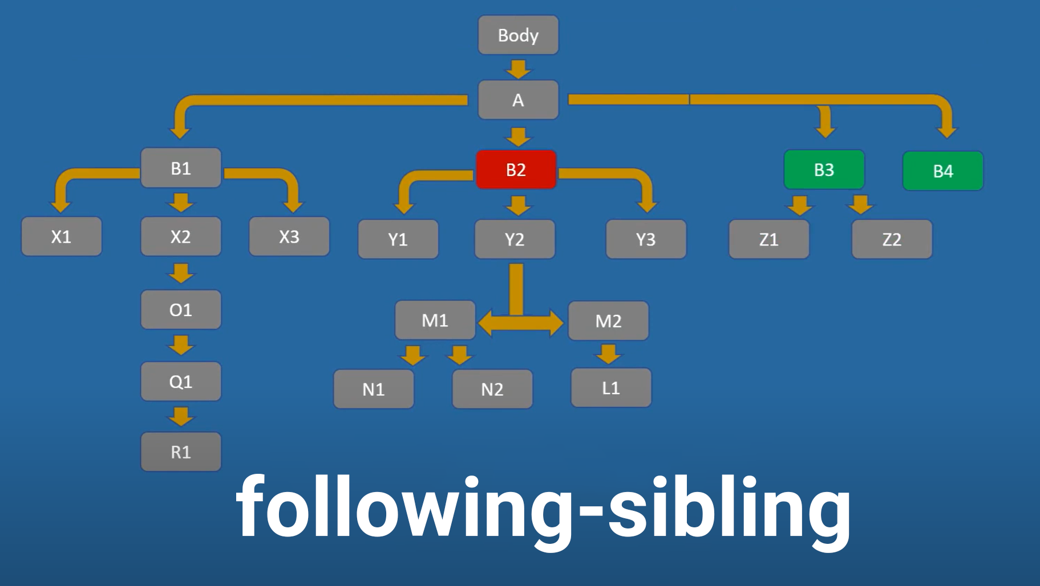
//* [@id=‘abc’] / following-sibling :: *[@id=‘def’]

Slide 39
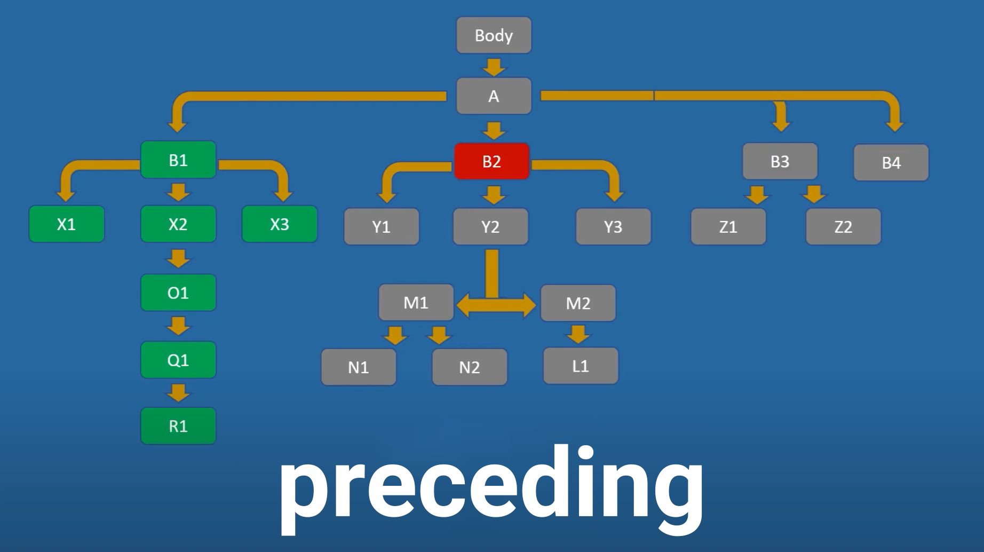
//* [@id=‘abc’] / preceding :: *[@id=‘def’]

Slide 40
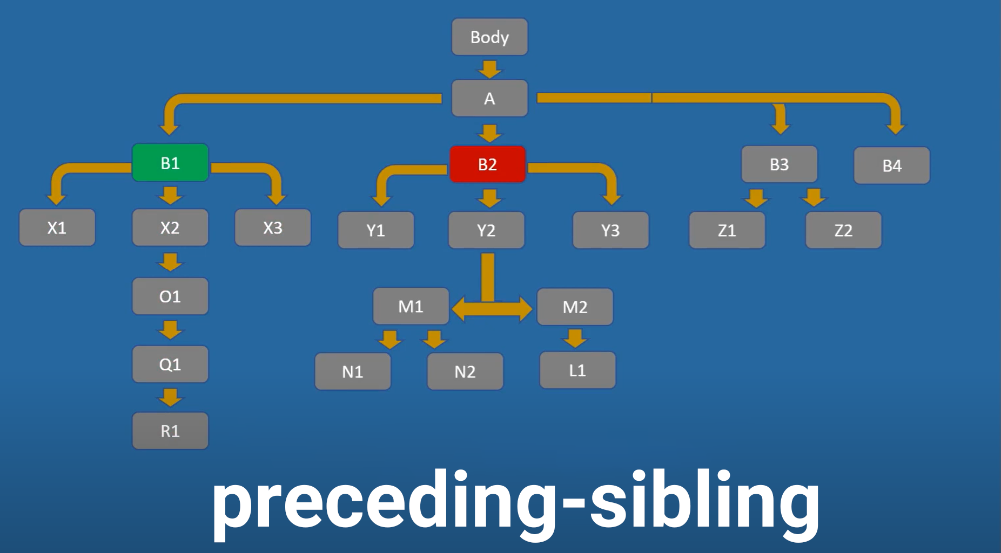
//* [@id=‘abc’] / preceding-sibling :: *[@id=‘def’]

Slide 41
Session 7
Page Object Model
Project Structure
Setup / Default / Teardown
Run using Unittest
HTML Report

Slide 42
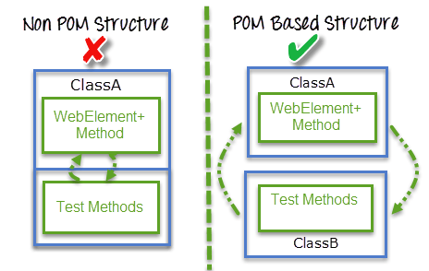
Page Object Model

Slide 43
Session 8 – Keyboard Actions
Typing with Keyboard
Press ENTER
Pressing of Key Combination Like CTRL+ A
Release pressed keys
Clear the text using clear()
Clear the text using CTRL+A+DEL

Slide 44
Session 9 – Mouse Actions
Click
Double Click
Right Click
Move Cursor
Click and Hold
Release
Drag and Drop1
Drag and Drop2
Offset of element (Coordinates)
Move by offset
Drag and Drop by offset
Element rect

Slide 46
Session 10 – Scroll
Scroll using JavaScript Commands
Scroll using ActionsChains library
Scroll using Keyboard (KEYS)
Scroll using WebDriver itself

Slide 47
Scroll using JavaScript commands
Scroll down by pixel
Scroll to specific position
Scroll to element if could find by driver
Scroll to element if currently cannot be found or not sure if it is in the page
Scroll to down of the page
Scroll to top of the page
Scroll horizontally

Slide 48
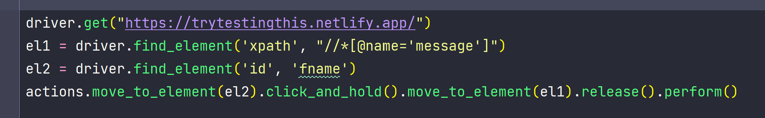
Scroll using ActionChains

Slide 49
Scroll using Keyboard
Scroll to down of the page
Scroll to top of the page
Scroll to find element

Slide 50
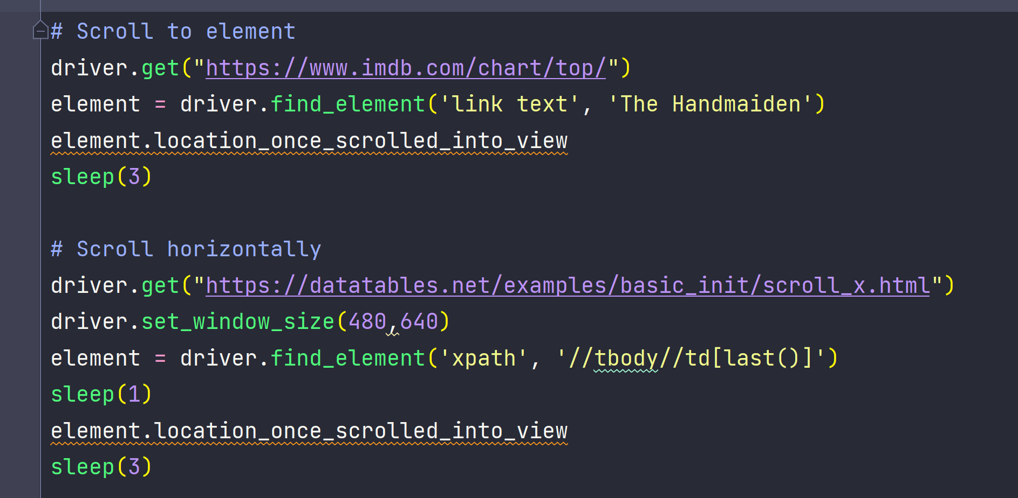
Scroll using WebDriver

Slide 51
Session 11 – Get attributes of elements
‘By’ class
Get Text
Get Class/Link, etc.…
Check element is selected
Check “Radio button” status
Check “Switch button” status
Check “Checkbox” status
Check Enable/Disable
Get value of input
Check invalid input (field errors)

Slide 52
Session 12 – Conditional Waits
Sleep
Implicitly Wait
Wait until element has an attribute
Wait until element has not an attribute
Wait until element is disable/enable
Wait until element is visible
Wait until element is disappear
WebDriverWait until Expected Conditions
Wait until page is loaded

Slide 53
Session 13
Tricks for:
Alert
Dialog (Popup)
Snackbar (Toast)
Tooltip

Slide 54
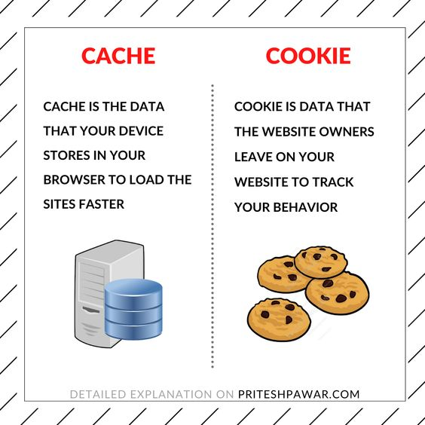
Session 14 – Store Cache

Slide 55
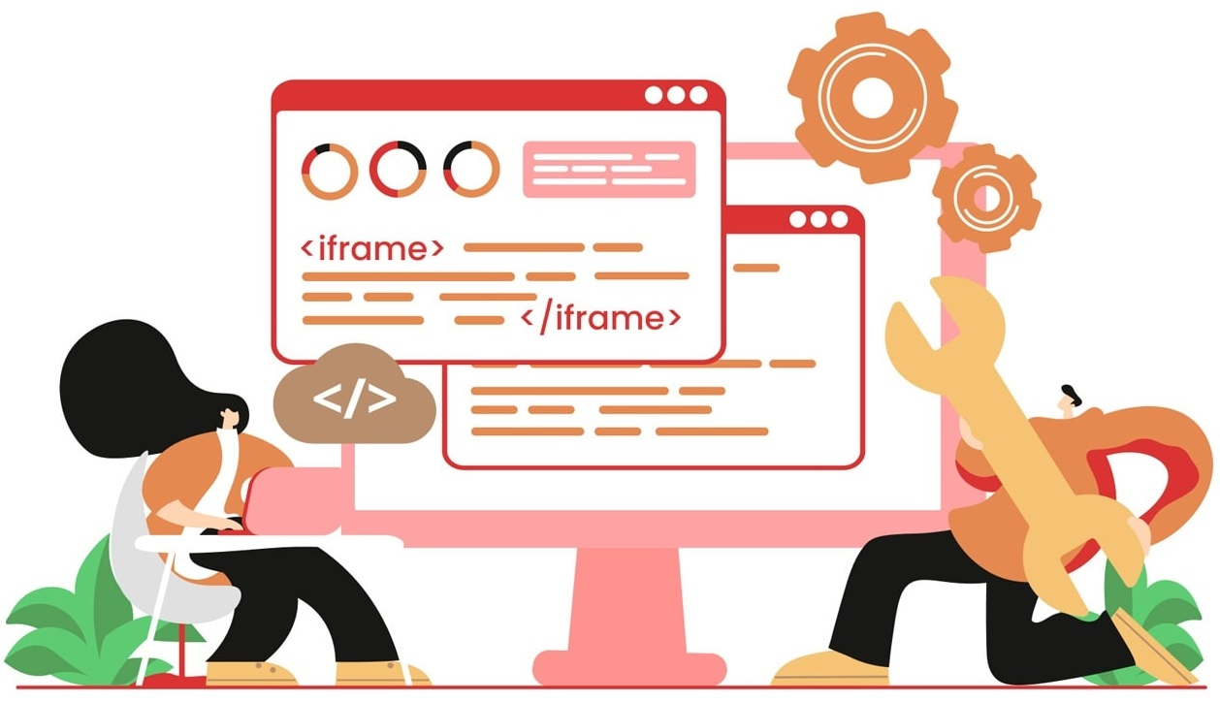
Session 15 – iFrames

Slide 56
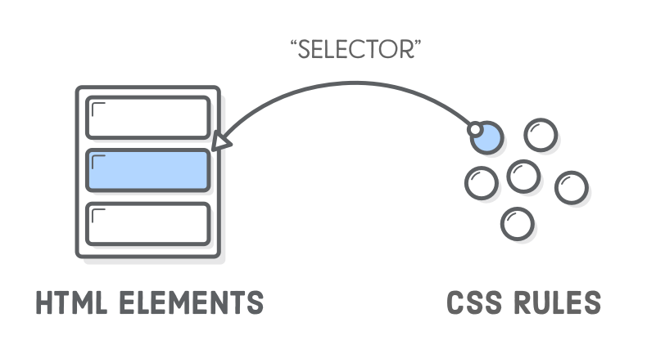
Session 16 – CSS Selectors

Slide 57
Advantages
1- CSS selectors perform better, faster, and more reliably than
XPath in most browsers
2- Necessary for execute JavaScript commands with driver if element is going to be selected with the command
3- All the JS-based test framework like Cypress use CSS selectors
4- Do some useful functions inside selector like ‘select all checked checkbox’ or ‘select all visited links’ which needs writing some functions to achieve normally.
5- A mandatory fundamental for Frontend developers

Slide 58
Basic Syntax
tag [ AttrName = ‘AttrValue’]
Sample expressions:
input[ id = ‘fname’]
button[ value = ‘submit’]

Slide 59
ID & Class Selectors
tag # ID-value
input # fname
tag . Class-value
div . tooltip

Slide 60
Combination
tag # ID-value [ AttrName = ‘AttrValue’]
tag # ID-value . Class-value
AND (for attributes of a element)
tag # ID-value [ Attr1Name = ‘Attr1Value’] [ Attr2Name = ‘Attr2Value’]
OR (select any element of given expressions
tag1. Class-value , tag2 . Class-value

Slide 61
Sub-string Match
<input type="checkbox" id="moption“>
‘ ^ ‘ Starts with input[id^=‘mop’]
‘ $ ‘ Ends with input[id$=‘tion’]
‘ * ‘ Partial text input[id*=‘opt’]
Can be combined as well:
input[id*=‘opt’][type$=‘box’]

Slide 62
Child/Descendant
Direct child
tag # ID-value>tag # ID-value
Descendant (Child and sub-child)
tag # ID-value tag # ID-value
Next-sibling (Adjacent)
tag # ID-value+tag # ID-value

Slide 63
Pseudo Class - Child
First child
tag # ID-value :first-child
Last child
tag # ID-value :last-child
Select by Index
tag # ID-value :nth-child(index)
Select by Index
tag # ID-value :nth-last-child(index)

Slide 64
Pseudo Class – Type of child
First child of its type
tag # ID-value>tag # ID-value:first-of-type
Last child of its type
tag # ID-value>tag # ID-value:last-of-type
Nth child of its type
tag # ID-value>tag # ID-value :nth-of-type(index)

Slide 65
Pseudo Class
<tag>:checked Selects checked <tag> elements (e.g. input)
<tag>:disabled Selects disabled <tag> elements (e.g. button)
<tag>:enabled Selects enabled elements (e.g. button)
<tag>:empty Selects element that has no children
<tag>:hover Selects <tag> elements on mouse hover
<tag>:only-of-type Selects <tag> element that is the only <tag> of its parent
<tag>:only-child Selects <tag> element that is the only child of its parent
<tag>::placeholder Selects <tag> element with the place holder attribute specified
<tag>:invalid Selects all <tag> with invalid value (e.g. input)
<tag>:valid Selects all <tag> with valid value (e.g. input)
<tag>:link Selects all unvisited links
<tag>:visited Selects all visited links

Slide 66
Session 19 - SeleniumWire
Capture Requests & Responses
Wait for a Request
Intercept > Block a Request
Intercept > Update Request Body
Intercept > Mock a Response
Delete Interceptor

